Slide 1
Classification
Logistic regression
Neural network
Support vector machine (SVM)

Slide 2

Optimization objective
Support Vector
Machines
Machine Learning

Slide 3

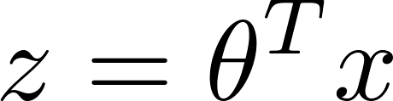
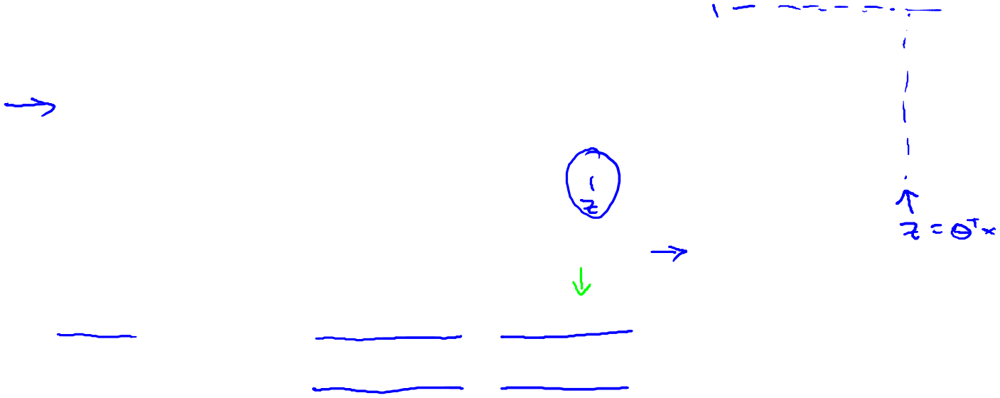
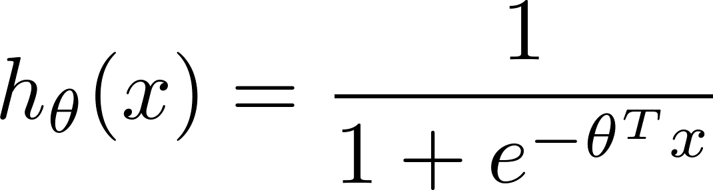
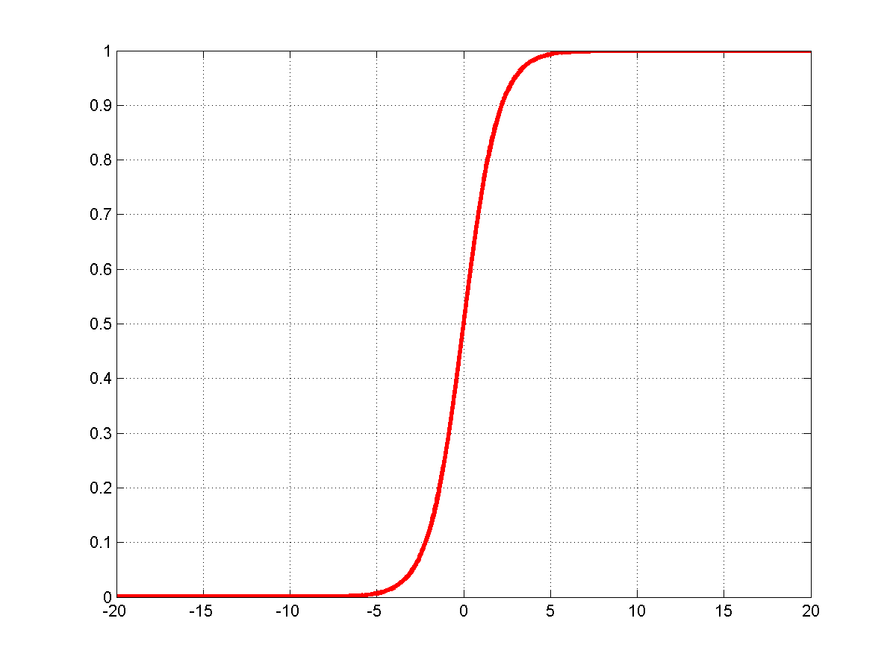
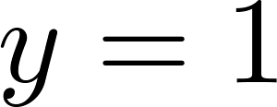
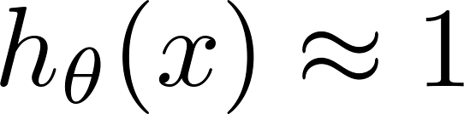
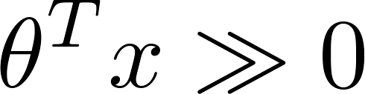
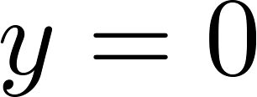
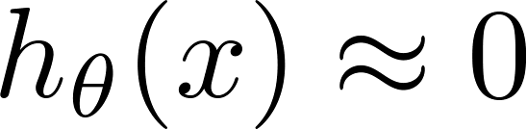
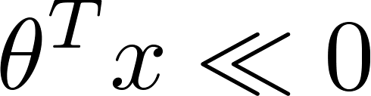
Alternative view of logistic regression
1
If , we want ,
0.5
If , we want ,

Slide 4
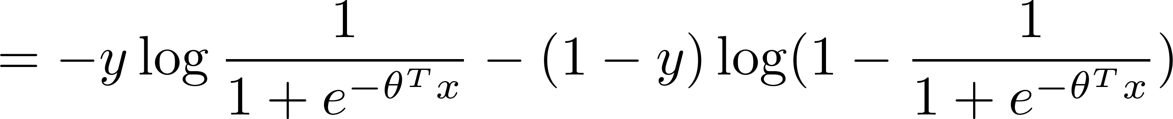
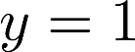
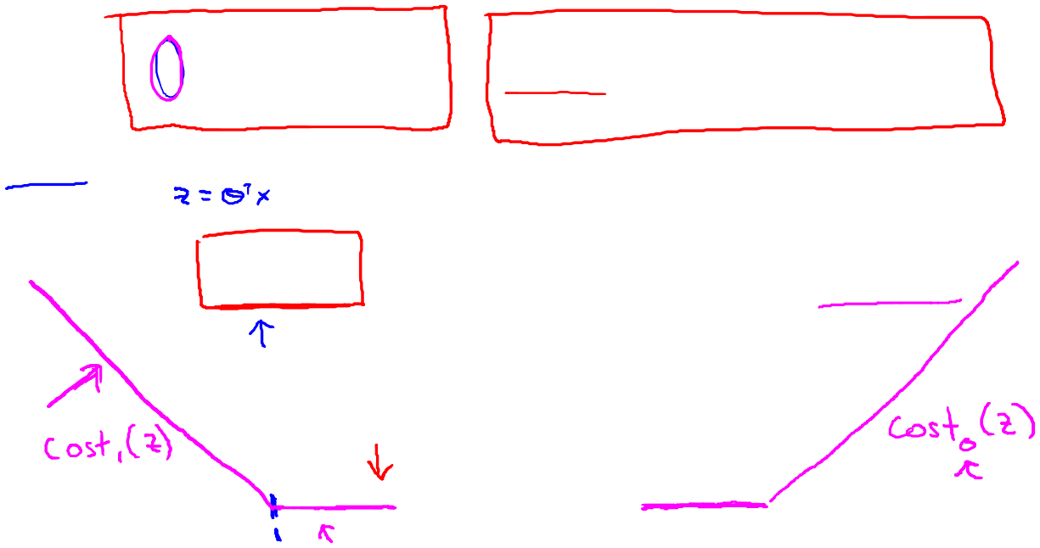
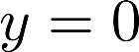
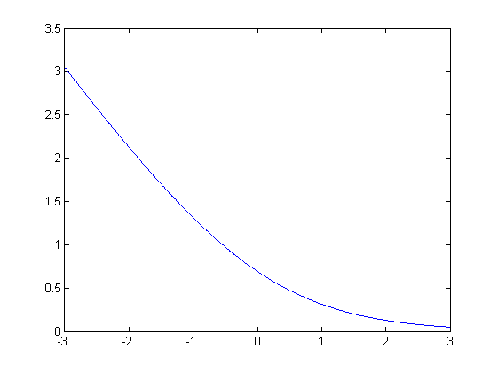
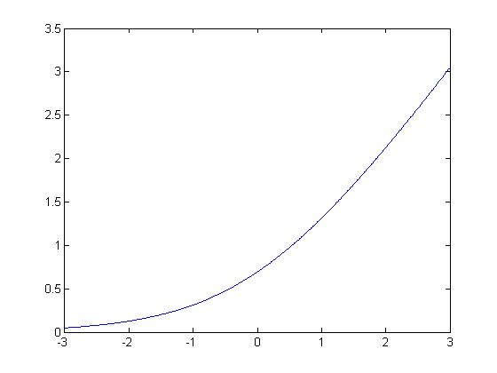
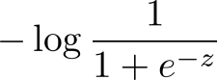
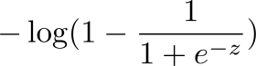
Alternative view of logistic regression
Cost of example:
If (want ):
If (want ):

Slide 5
Support vector machine
Logistic regression:
Support vector machine:

Slide 6
SVM hypothesis
Hypothesis:

Slide 7
Large Margin Intuition
Support Vector
Machines
Machine Learning
Large margin classifier

Slide 8
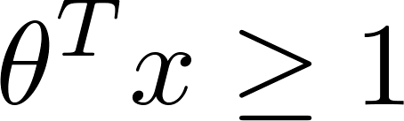

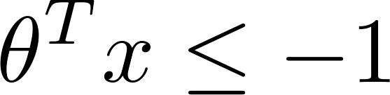

Support Vector Machine
-1
1
-1
1
If , we want (not just )
If , we want (not just )

Slide 9
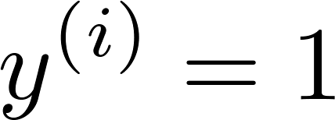
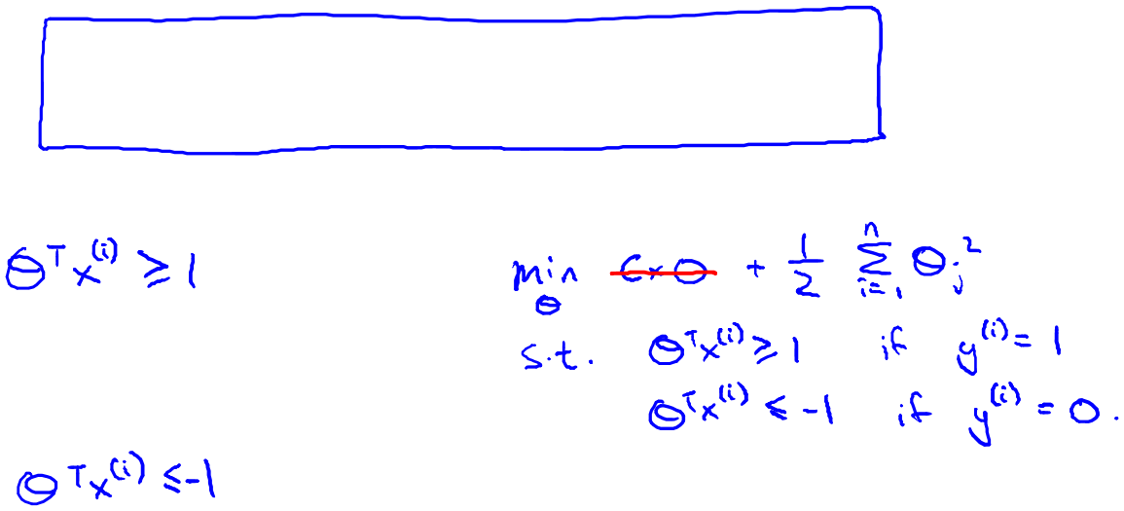
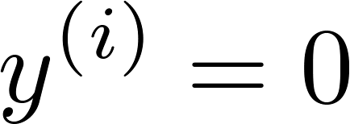
SVM Decision Boundary
Whenever :
-1
1
Whenever :
-1
1

Slide 10
SVM Decision Boundary: Linearly separable case
x₂
Margin
x₁
Large margin classifier

Slide 11
Large margin classifier in presence of outliers
x₂
C is not too large
x₁

Slide 12
The mathematics behind large margin classification (optional)
Support Vector
Machines
Machine Learning

Slide 14
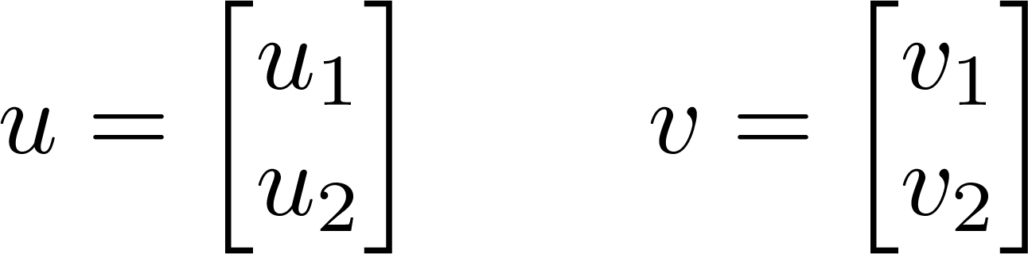
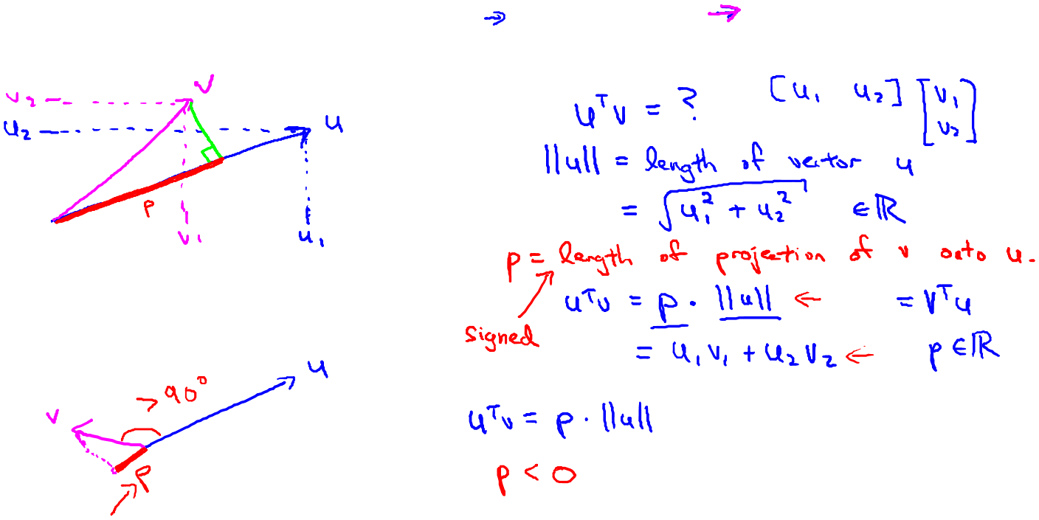
Vector Inner Product

Slide 15
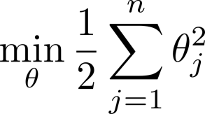
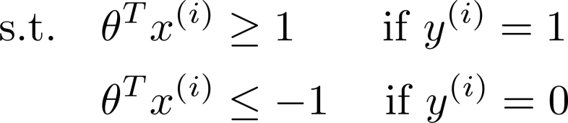
SVM Decision Boundary

Slide 16
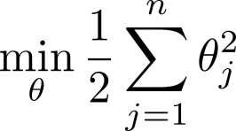
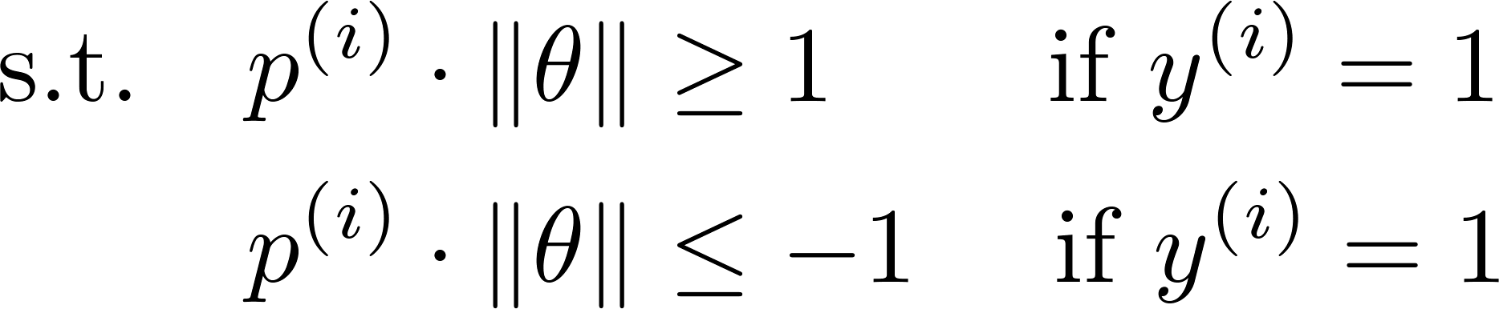
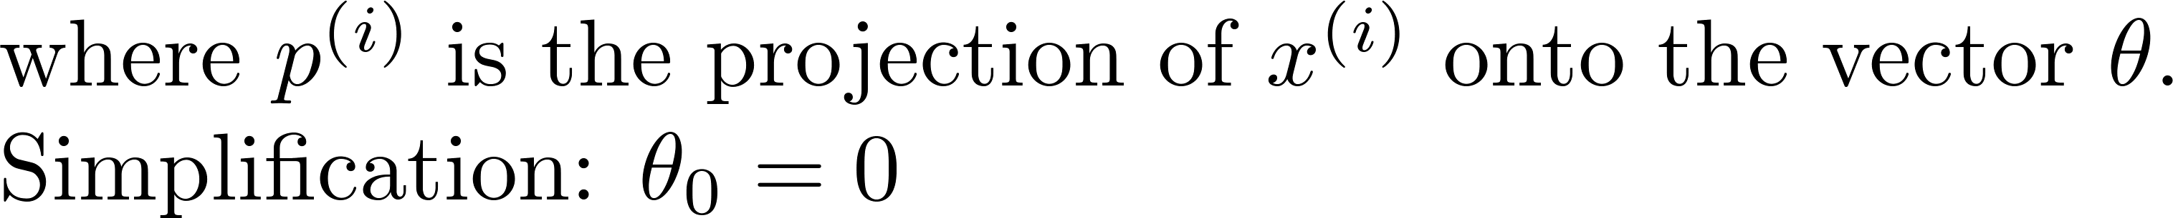
SVM Decision Boundary

Slide 17
Kernels I
Support Vector
Machines
Machine Learning

Slide 18

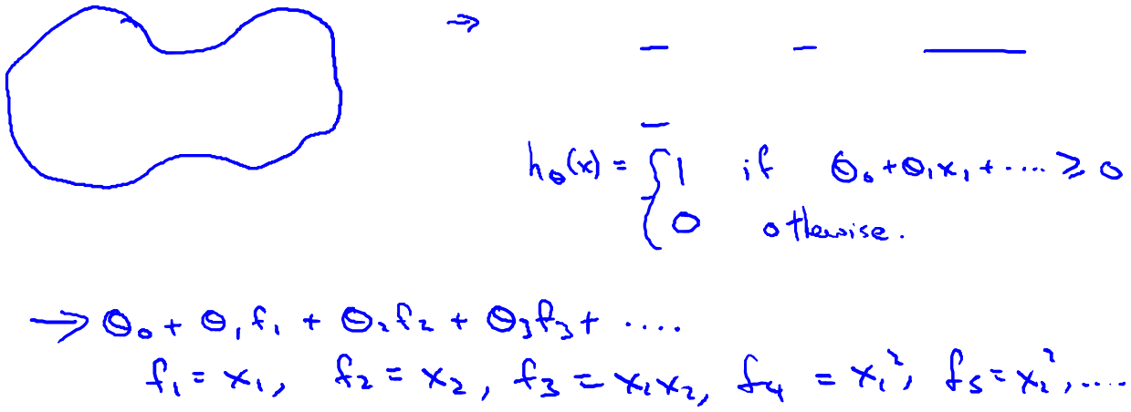
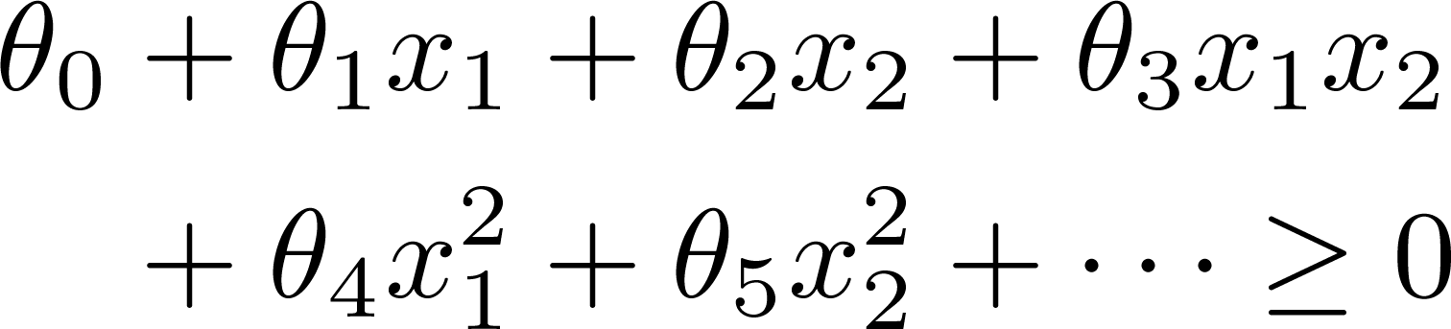

Non-linear Decision Boundary
x₂
x₁
Is there a different / better choice of the features ?

Slide 19
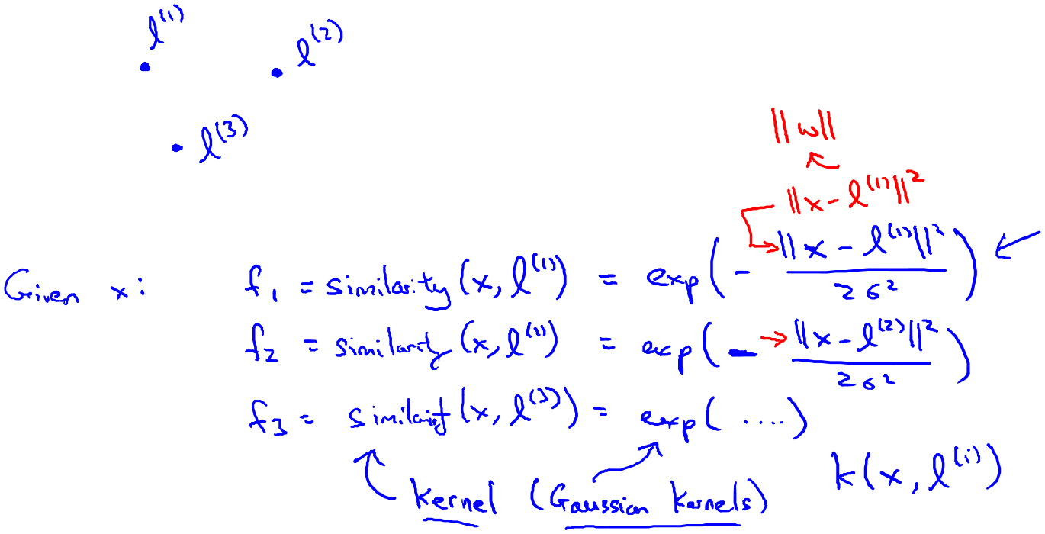
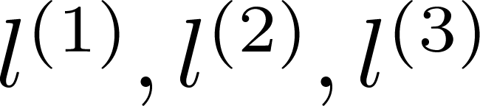
Kernel
Given , compute new feature depending
on proximity to landmarks
x₂
x₁

Slide 20

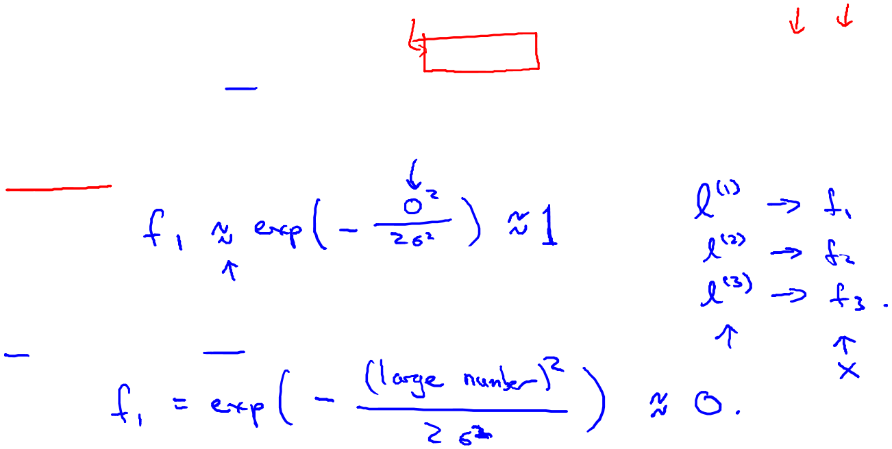

Kernels and Similarity

Slide 21
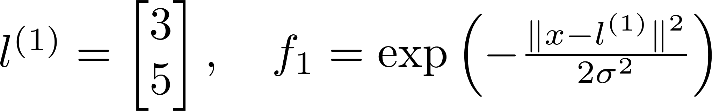
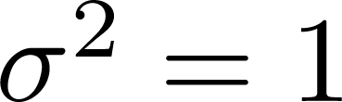
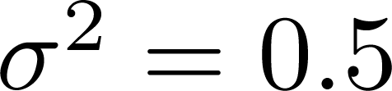
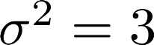
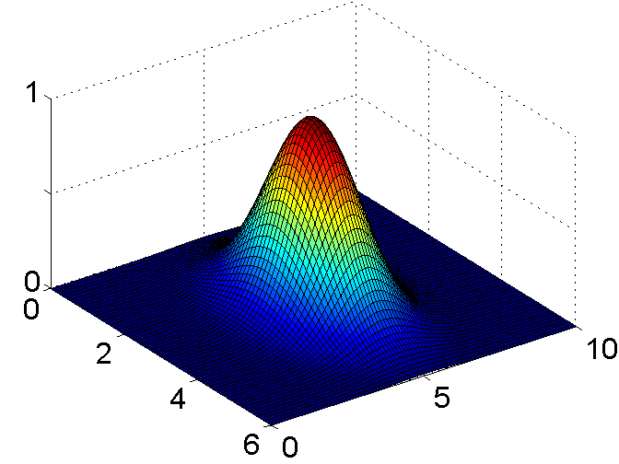
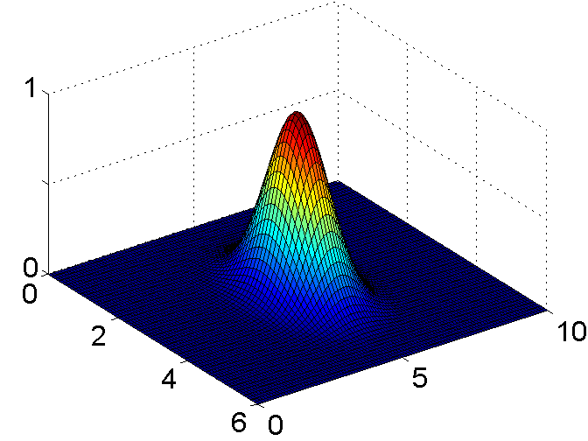
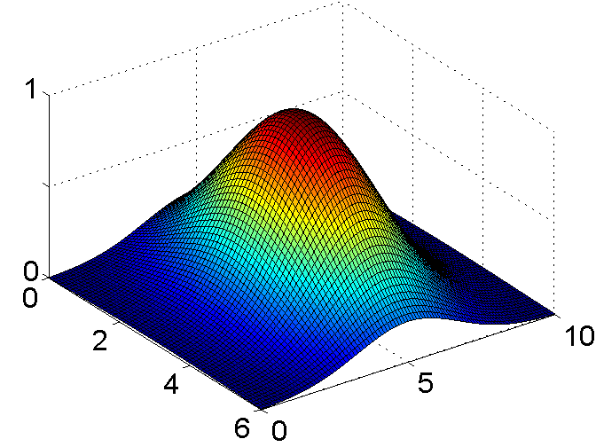
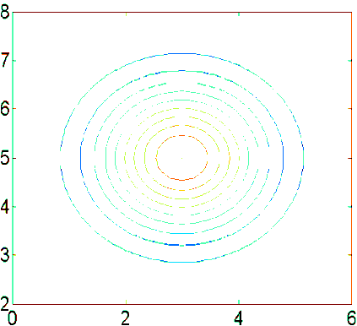
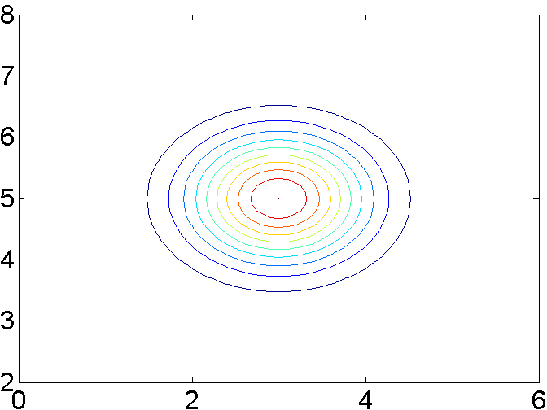
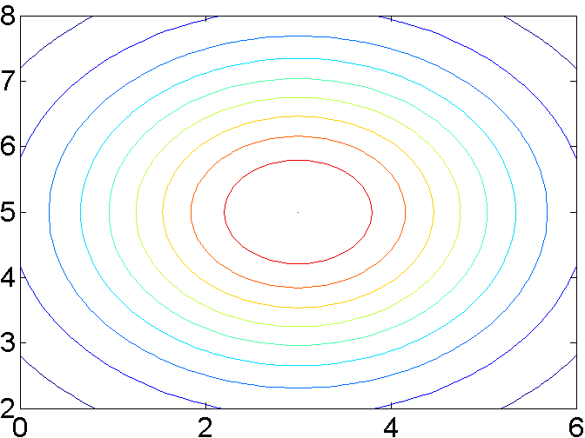
Example:

Slide 22
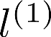
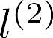
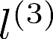
x₂
x₁

Slide 23
Kernels II
Support Vector
Machines
Machine Learning

Slide 24

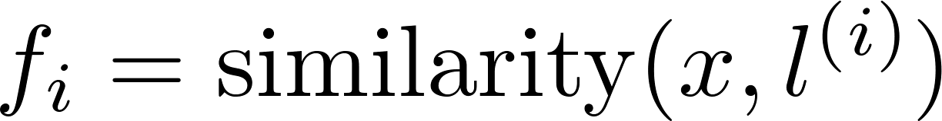
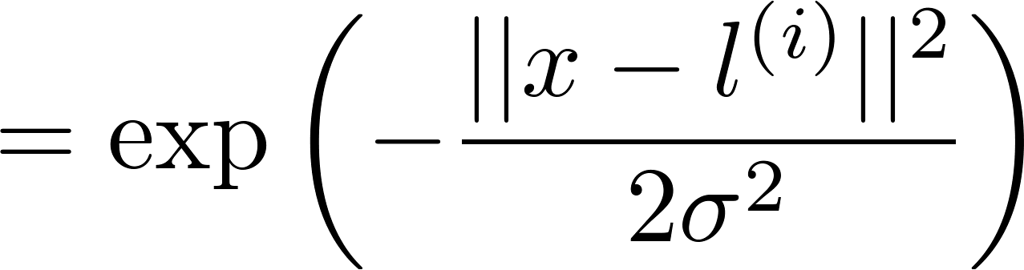


Choosing the landmarks
Given :
x₂
x₁
Predict if
Where to get ?

Slide 25




SVM with Kernels
Given
choose
Given example :
For training example :

Slide 26



SVM with Kernels
Hypothesis: Given , compute features
Predict “y=1” if
Training:

Slide 27




SVM parameters:
C ( ). Large C: Lower bias, high variance.
Small C: Higher bias, low variance.
Large : Features vary more smoothly.
Higher bias, lower variance.
Small : Features vary less smoothly.
Lower bias, higher variance.

Slide 28
Using an SVM
Support Vector Machines
Machine Learning

Slide 29





Use SVM software package (e.g. liblinear, libsvm, …) to solve for parameters .
Need to specify:
Choice of parameter C.
Choice of kernel (similarity function):
E.g. No kernel (“linear kernel”)
Predict “y = 1” if
Gaussian kernel:
, where .
Need to choose .

Slide 30
LIBSVM -- A Library for Support Vector Machines
LIBSVM provides a simple interface where users can easily link it with their own programs. Main features of LIBSVM include
Different SVM formulations
Efficient multi-class classification
Cross validation for model selection
Probability estimates
Various kernels (including precomputed kernel matrix)
Weighted SVM for unbalanced data
Both C++ and Java sources
GUI demonstrating SVM classification and regression
Python, R, MATLAB, Perl, Ruby, Weka, Common LISP, CLISP, Haskell, OCaml, LabVIEW, and PHP interfaces. C# .NET code and CUDA extension is available.
It's also included in some data mining environments: RapidMiner, PCP, and LIONsolver.
Automatic model selection which can generate contour of cross valiation accuracy.
https://github.com/cjlin1/libsvm

Slide 31

Kernel (similarity) functions:
function f = kernel(x1,x2)
return
x1 x2
Note: Do perform feature scaling before using the Gaussian kernel.

Slide 32

Other choices of kernel
Note: Not all similarity functions make valid kernels.
(Need to satisfy technical condition called “Mercer’s Theorem” to make sure SVM packages’ optimizations run correctly, and do not diverge).
Many off-the-shelf kernels available:
Polynomial kernel:
More esoteric: String kernel, chi-square kernel, histogram intersection kernel, …

Slide 33






Multi-class classification
Many SVM packages already have built-in multi-class classification functionality.
Otherwise, use one-vs.-all method. (Train SVMs, one to distinguish
from the rest, for ), get
Pick class with largest

Slide 34





Logistic regression vs. SVMs
number of features ( ), number of training examples
If is large (relative to ):
Use logistic regression, or SVM without a kernel (“linear kernel”)
N=10000, m=1000
If is small, is intermediate:
Use SVM with Gaussian kernel
N=1000, m=10000
If is small, is large:
Create/add more features, then use logistic regression or SVM without a kernel
N=1000, m=50000+
Neural network likely to work well for most of these settings, but may be slower to train.

Slide 35


Slide 36


Slide 37


Slide 42


eWatcher

Slide 43


Slide 44


Slide 45

P52
Sequential minimal optimization (SMO)
http://en.wikipedia.org/wiki/Sequential_minimal_optimization

Slide 46


Slide 47


Slide 48


Slide 49

P53

Slide 50


Slide 51

Overfit
High variance

Slide 52

Underfit
High bias

Slide 54

Overfit
High variance

Slide 55

Underfit
High bias

Slide 56

P54

Slide 57


Slide 58
C_vec = [0.01 0.03 0.1 0.3 1 3 10 30]';
sigma_vec = [0.01 0.03 0.1 0.3 1 3 10 30]';
error_val = zeros(length(C_vec),length(sigma_vec));
error_train = zeros(length(C_vec),length(sigma_vec));
for i = 1:length(C_vec)
for j = 1:length(sigma_vec)
model= svmTrain(X, y, C_vec(i), @(x1, x2) gaussianKernel(x1, x2, sigma_vec(j)));
predictions = svmPredict(model, Xval);
error_val(i,j) = mean(double(predictions ~= yval));
visualizeBoundary(X, y, model);
title(sprintf('C = %.2f, \\sigma=%.2f', C_vec(i), sigma_vec(j)));
print('-dpng', sprintf('../P54/Test Figs/c=%.2f_sigma=%.2f.png',C_vec(i), sigma_vec(j)));
end
end
Parameter test based on error analysis

Slide 59


Slide 60


Slide 61


Slide 62


P55

Slide 63
> Anyone knows how much it costs to host a web portal ?
>
Well, it depends on how many visitors you're expecting.
This can be anywhere from less than 10 bucks a month to a couple of $100.
You should checkout http://www.rackspace.com/ or perhaps Amazon EC2
if youre running something big..
To unsubscribe yourself from this mailing list, send an email to:
groupname-unsubscribe@egroups.com

Slide 64
Preprocessing Emails
Extracting Features
Training SVM
Predicting SPAM

Slide 65

Preprocessing Emails

Slide 66

Preprocessing Emails

Slide 67
> Anyone knows how much it costs to host a web portal ?
>
Well, it depends on how many visitors you're expecting.
This can be anywhere from less than 10 bucks a month to a couple of $100.
You should checkout http://www.rackspace.com/ or perhaps Amazon EC2
if youre running something big..
To unsubscribe yourself from this mailing list, send an email to:
groupname-unsubscribe@egroups.com
anyon know how much it cost to host a web portal well it depend on how mani visitor your expect thi can be anywher from less than number buck a month to a coupl of dollarnumb you should checkout httpaddr or perhap amazon ecnumb if your run someth big to unsubscrib yourself from thi mail list send an email to emailaddr

Slide 68

Extracting Features
deal
buy
discount
Andrew
now
…
From: cheapsales@buystufffromme.com
To: ang@cs.stanford.edu
Subject: Buy now!
Deal of the week! Buy now!
NOTE: In practice, take most frequently occurring n words ( 10,000 to 50,000) in training set, rather than manually pick 100 words.

Slide 69
Preprocessing Emails
Extracting Features
% Extract Features
file_contents = readFile('emailSample1.txt');
word_indices = processEmail(file_contents);
function x = emailFeatures(word_indices)
n = 1899;
x = zeros(n, 1);
x(word_indices) = 1;

Slide 70


Vocabulary List

Slide 71
Training SVM
load('spamTrain.mat');
fprintf('\nTraining Linear SVM (Spam Classification)\n')
fprintf('(this may take 1 to 2 minutes) ...\n')
C = 0.1;
model = svmTrain(X, y, C, @linearKernel);

Slide 72
Predicting SPAM
p = svmPredict(model, X);
fprintf('Training Accuracy: %f\n', mean(double(p == y)) * 100);

Slide 73
Top predictors of spam:
our (0.493094)
click (0.466972)
remov (0.414133)
guarante (0.384250)
visit (0.371709)
basenumb (0.343388)
dollar (0.329178)
will (0.269012)
price (0.268814)
pleas (0.261181)
most (0.258657)
nbsp (0.252986)
lo (0.252240)
ga (0.243186)
dollarnumb (0.239150)

Slide 74

It is really a long long journey …

Slide 75
What we learned?

Slide 76
Linear regression
Nonlinear regression
Logistic regression
Neural network
Support Vector Machine (SVM)
Regularization
Parameter selection
Error analysis

Slide 77
SUPERVISED LEARNING
Regularization
Parameter selection
Error analysis

Slide 78
No big deal
But credible implementations

Slide 79







Slide 80
Know the big persons

Slide 81



Yann LeCun
Andrew NG
Geoffrey Hinton

Slide 82
Machine learning sometimes is the most effective (or only) solution to some applications

Slide 83
Do believe all you focused today will repaid you tomorrow

Slide 84



Slide 85

The people who are crazy enough to think they can change the world, are the ones who do!

Slide 86

World is small,
we would meet again
…
sunzuolei@gmail.com

